Slide 1
Hostel Management System
Mini Project

Slide 2
PRESENTED BY,
1. Vinod Kumar .L - 950019104050
2. Kaikondar .S - 950019104019
3. Basvan .V - 950019104009
4. Sathees Kumar.K - 950019104302
Under the guidance of:
Dr.S.Sabena AP/CSE

Slide 3
INTRODUCTION
✦ HOSTEL MANAGEMENT SYSTEM is proposed to reduce the problems faced by the traditional systems .
✦ The proposed system is designed to limit the human works and make hostel allocation much easier for students and hostel administrators.
✦ This system includes the following modules : Student Registration,
Leave Letter Management, Mess billing, Room Management.
✦All the events and activities that take place in the college is updated regularly by the admin.

Slide 4
OBJECTIVE
To Develop a Web app for Hostel Management System which can automate all the manual operations of the hostel.

Slide 5
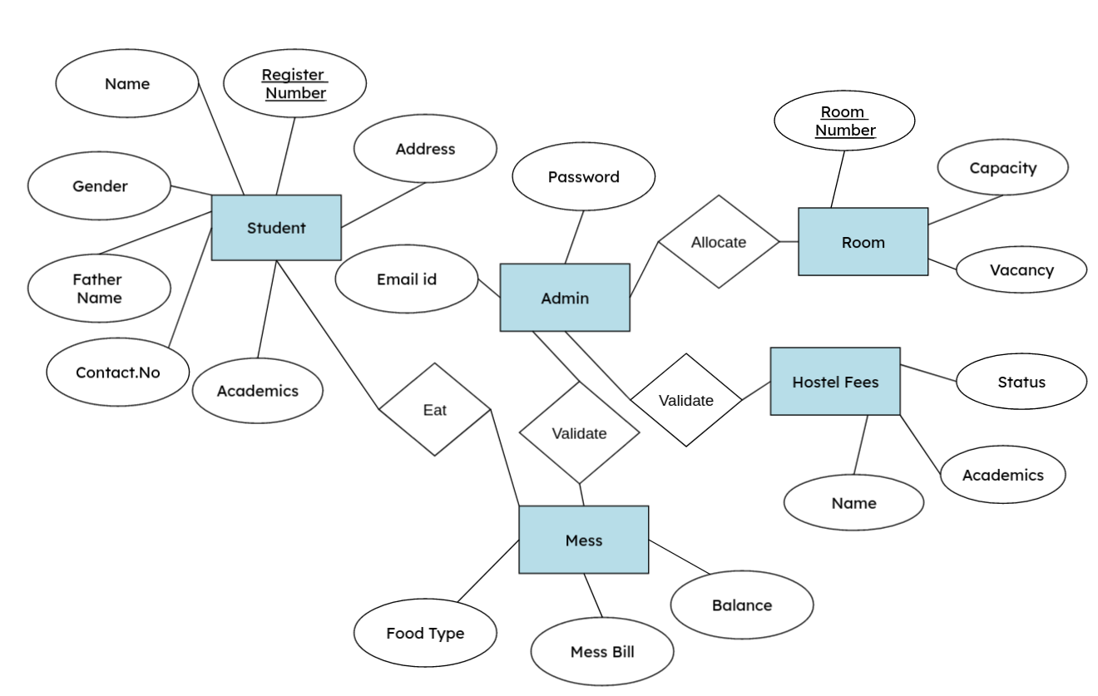
ARCHITECTURAL DESIGN FOR THE PROPOSED SYSTEM
Entity Relationship Diagram:

Slide 6
MODULES DESCRIPTION IN DETAIL

Slide 7
ADMIN MODULE
✦ In Admin module, student details and staff details are entered by admin.
✦ Updation of student details and staff details can be performed by them.
LOGIN PAGE FOR ADMIN
✦ Describes admin must enter the username and password for login process.
If the Username and password is incorrect, then he/she is not allowed to log into the system.
✦ Forgot password and Reset, password options were also given.
Admin Can View Student Details
✦ Describes the process of viewing the details of students.
✦ Admin can view the details of a particular student such as Roll number, Name, Father’s Name, Gender, Place, Department, Academics, Food, Email, Father number and Student number

Slide 8
STUDENT MODULE
✦ In Student module, a new student can register in the hostel by filling the details form, the students can view their profile by logging with their username and password.
Login page for student
✦ Describes that the students must enter the username and password for login process .
Reset Password Option
✦ Describes that if the students want to reset their password By entering the username, old password and new password ,they can reset their password.
New User Registration Form
✦ Describes that, if a new user wants to register in the hostel they can register by using the new user module.
Student’s Profile
✦ Describes the profile of students in which they can submit their leave letter form, upload the mess bill receipt, reset their password and they can also write their feedback about college hostel

Slide 9
ROOM MANAGEMENT MODULE
✦ In Room management module, the rooms are allocated for the hostel students respectively. The rooms are allocated separately for both boys and girls by the admin.
Room Availability For Students
✦ Describes the room availability for hostel students. Rooms are allocated to the students by the admin of the hostel and editing the details is done by caretaker of the hostel.
Viewing Room Availability
✦ Describes the availability of rooms in the hostel can be viewed by the students which is updated by the caretaker of hostel.

Slide 10
MESS BILL MANAGEMENT MODULE
✦ In mess bill module, the student can pay their mess bill and the admin can update the students who have paid the mess bill.
Uploading Mess Bill Receipt
✦ Describes that the students are asked to insert their receipt of the mess bill using insert option and that image of their receipt is viewed by the admin.
Alert Message For Mess Fees Balance
✦ Shows an alert message of mess fees balance for the students while uploading their mess bill receipt.
Viewing Mess bill Receipts
✦ Describes the mess bill receipts uploaded by the students can be viewed by the
admin. The receipts can be viewed separately for both boys and girls according to the academic year.

Slide 11
Summary
Hostel management system is designed to manage all hostel activities like hostel admissions, fees, room, mess allotment, hostel stores & generates related reports for smooth transactions. It is also used to manage monthly mess bill calculation, students details, room allotment.

Slide 12
Reference
For Languages: https://www.w3schools.com/

Slide 13
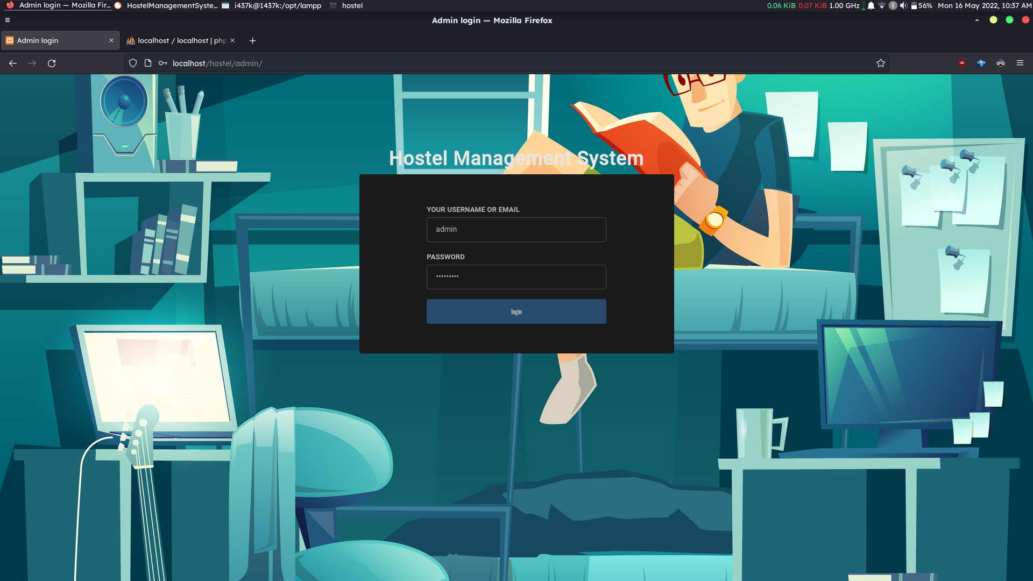
SCREENSHOTS : 70% Completion
Admin Login

Slide 14
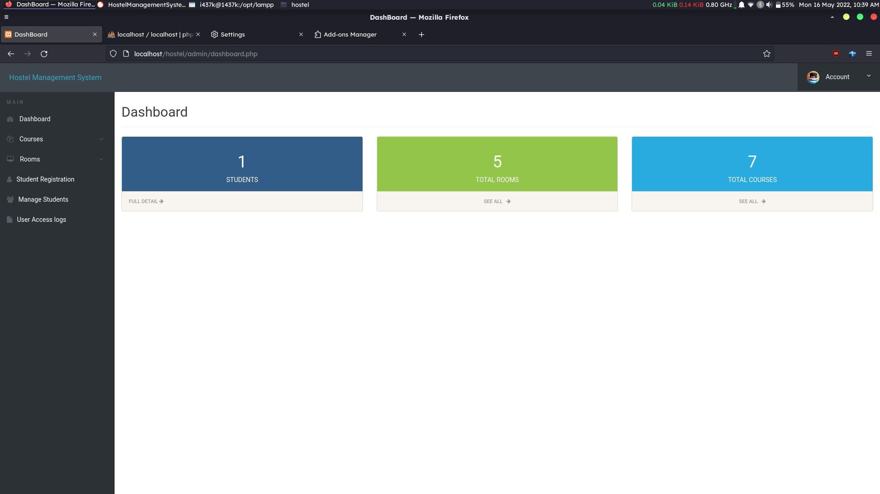
Admin DashBoard

Slide 15
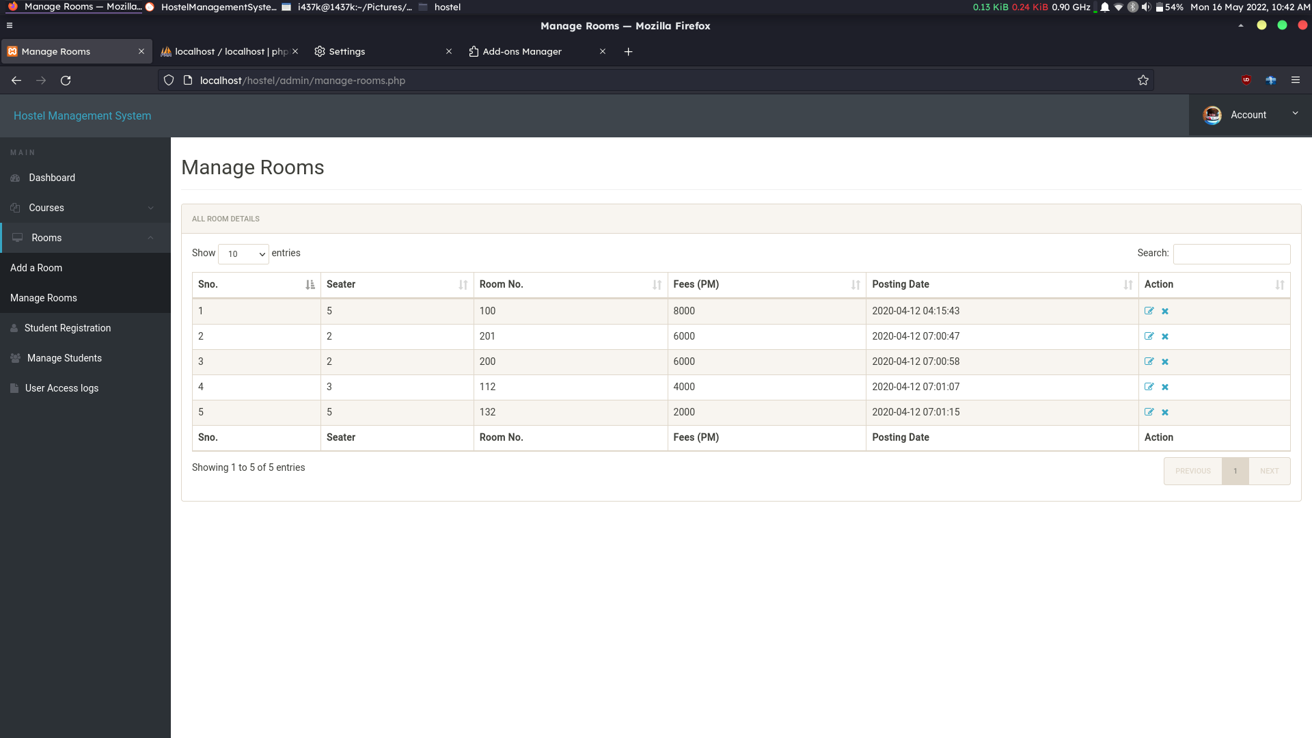
Room Management

Slide 16
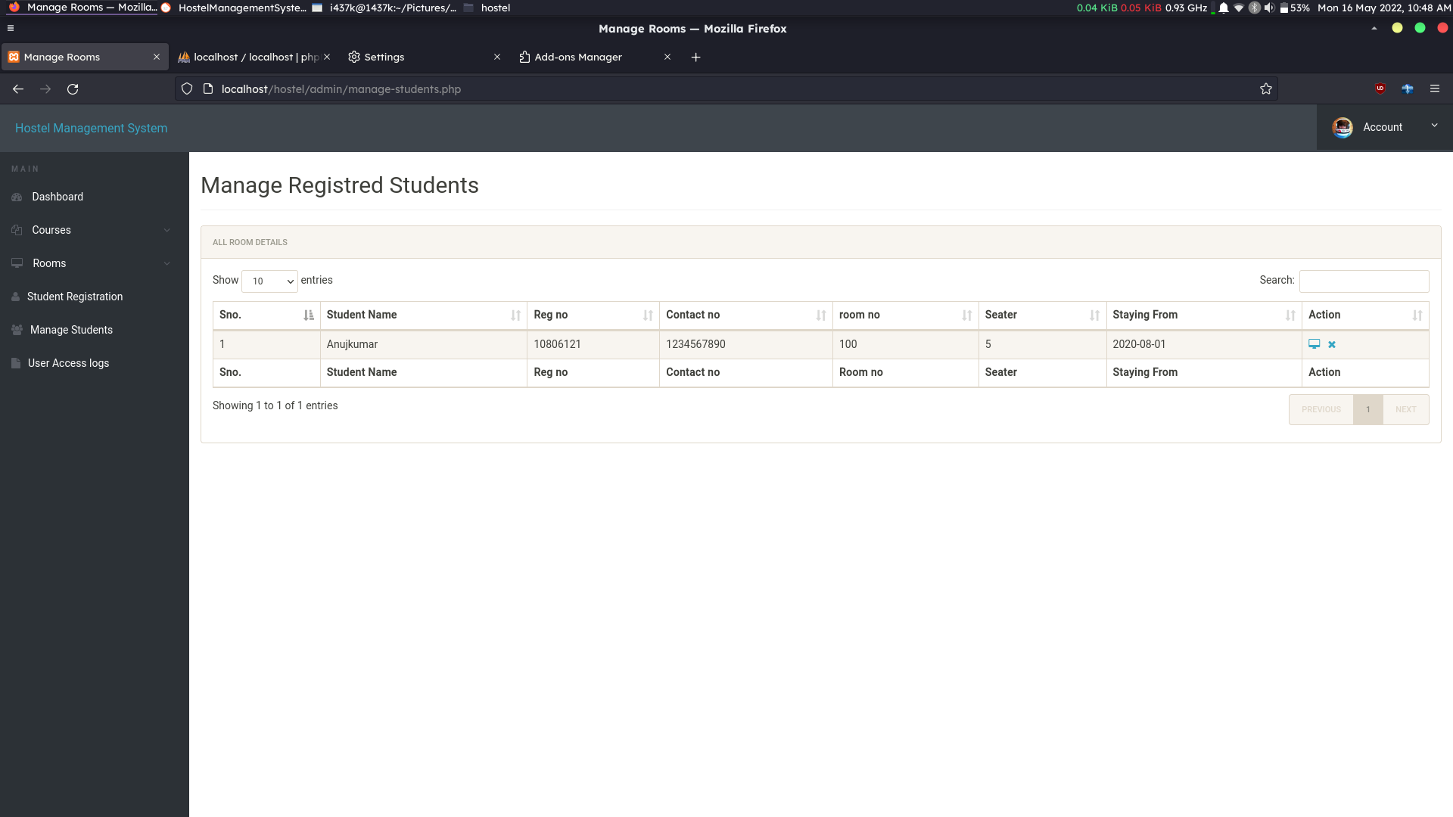
Student Management

Slide 17
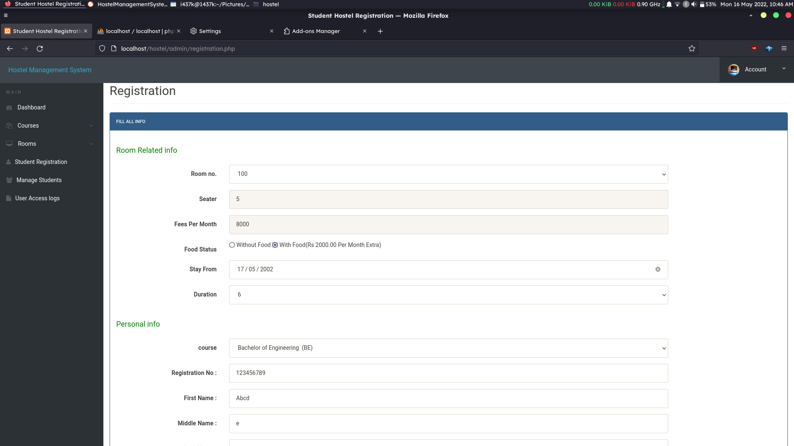
Student Registration

Slide 18
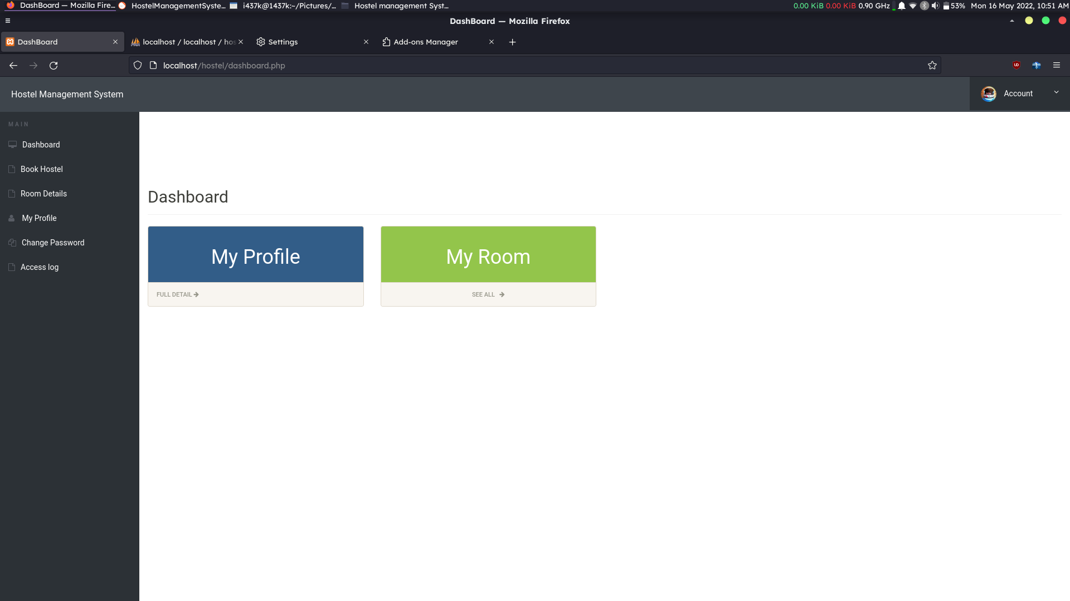
Student Dashboard

Slide 19
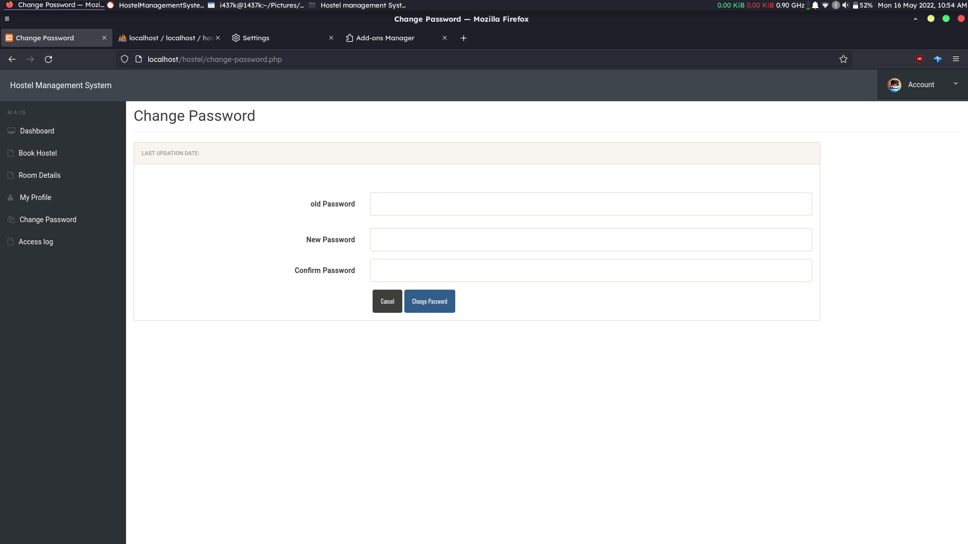
Student Password Reset

Slide 20
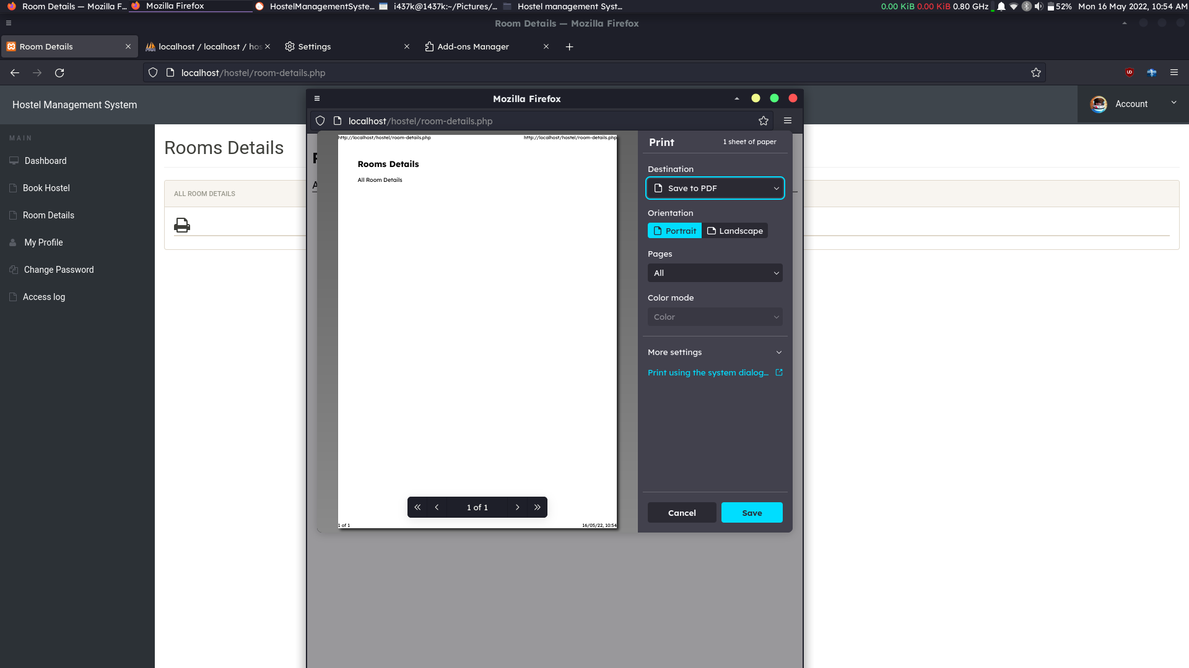
Student View Room Details

Slide 21
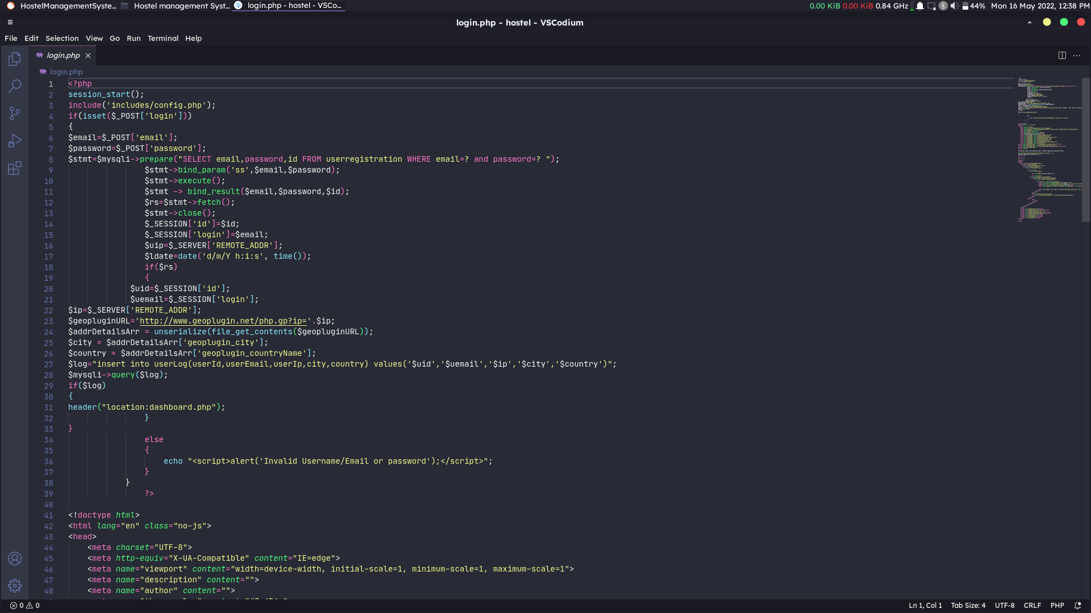
Source Code
Login.php

Slide 22
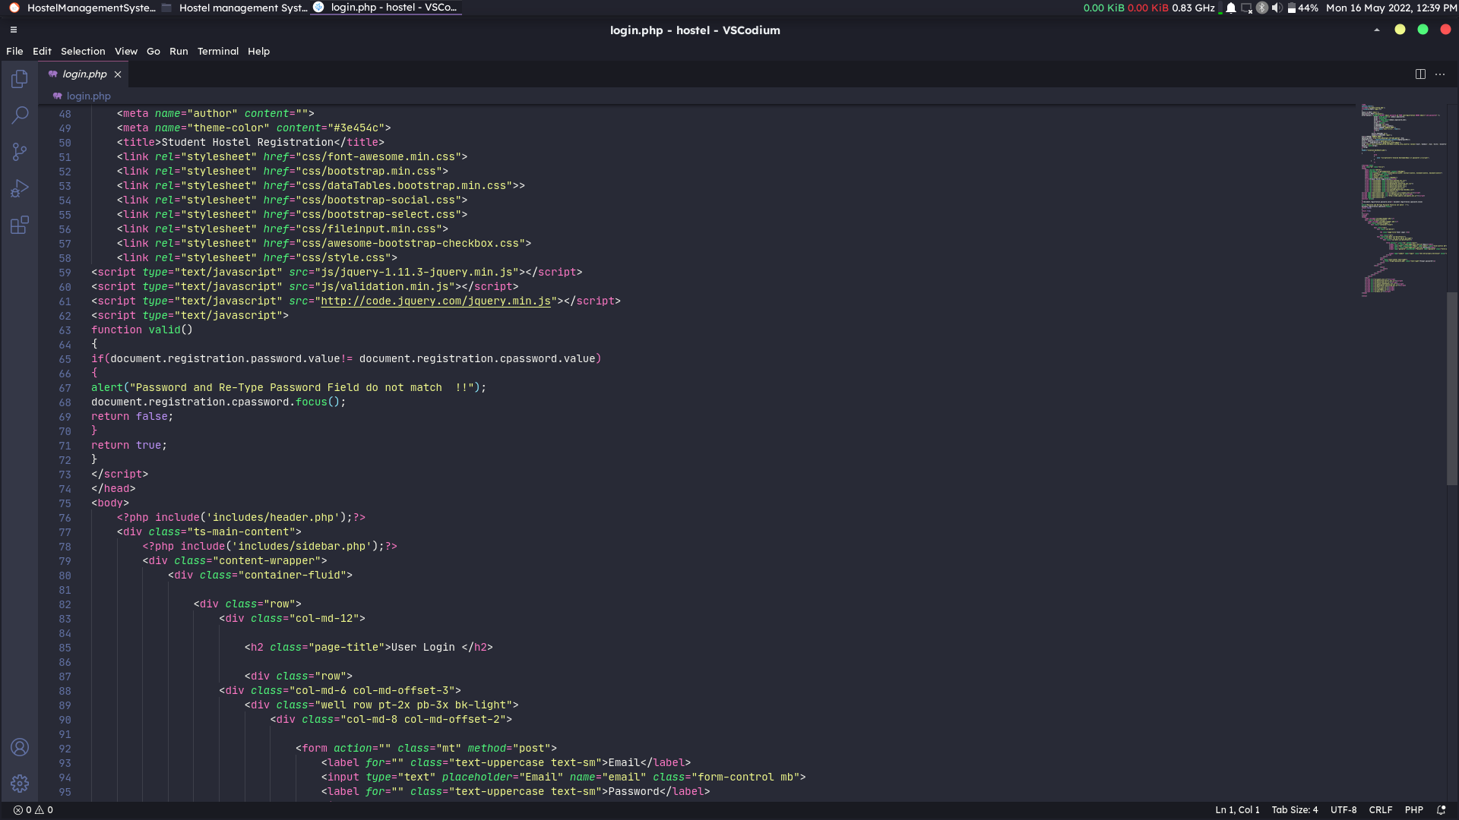
Login.php Page-2

Slide 23
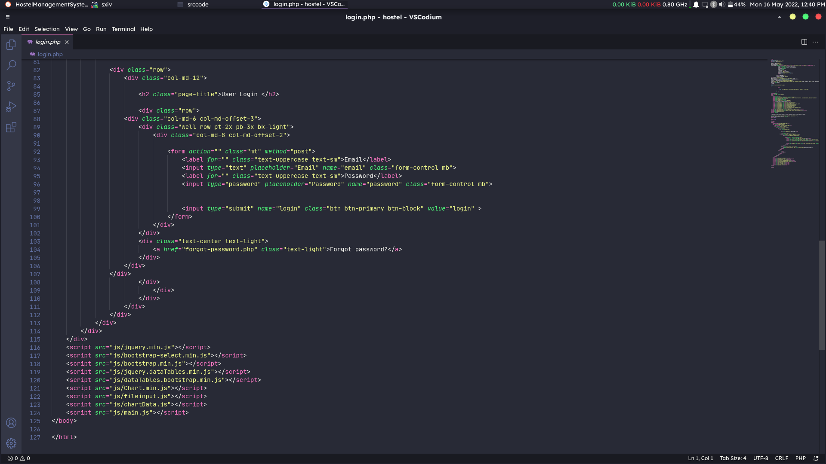
Login.php page-3

Slide 24
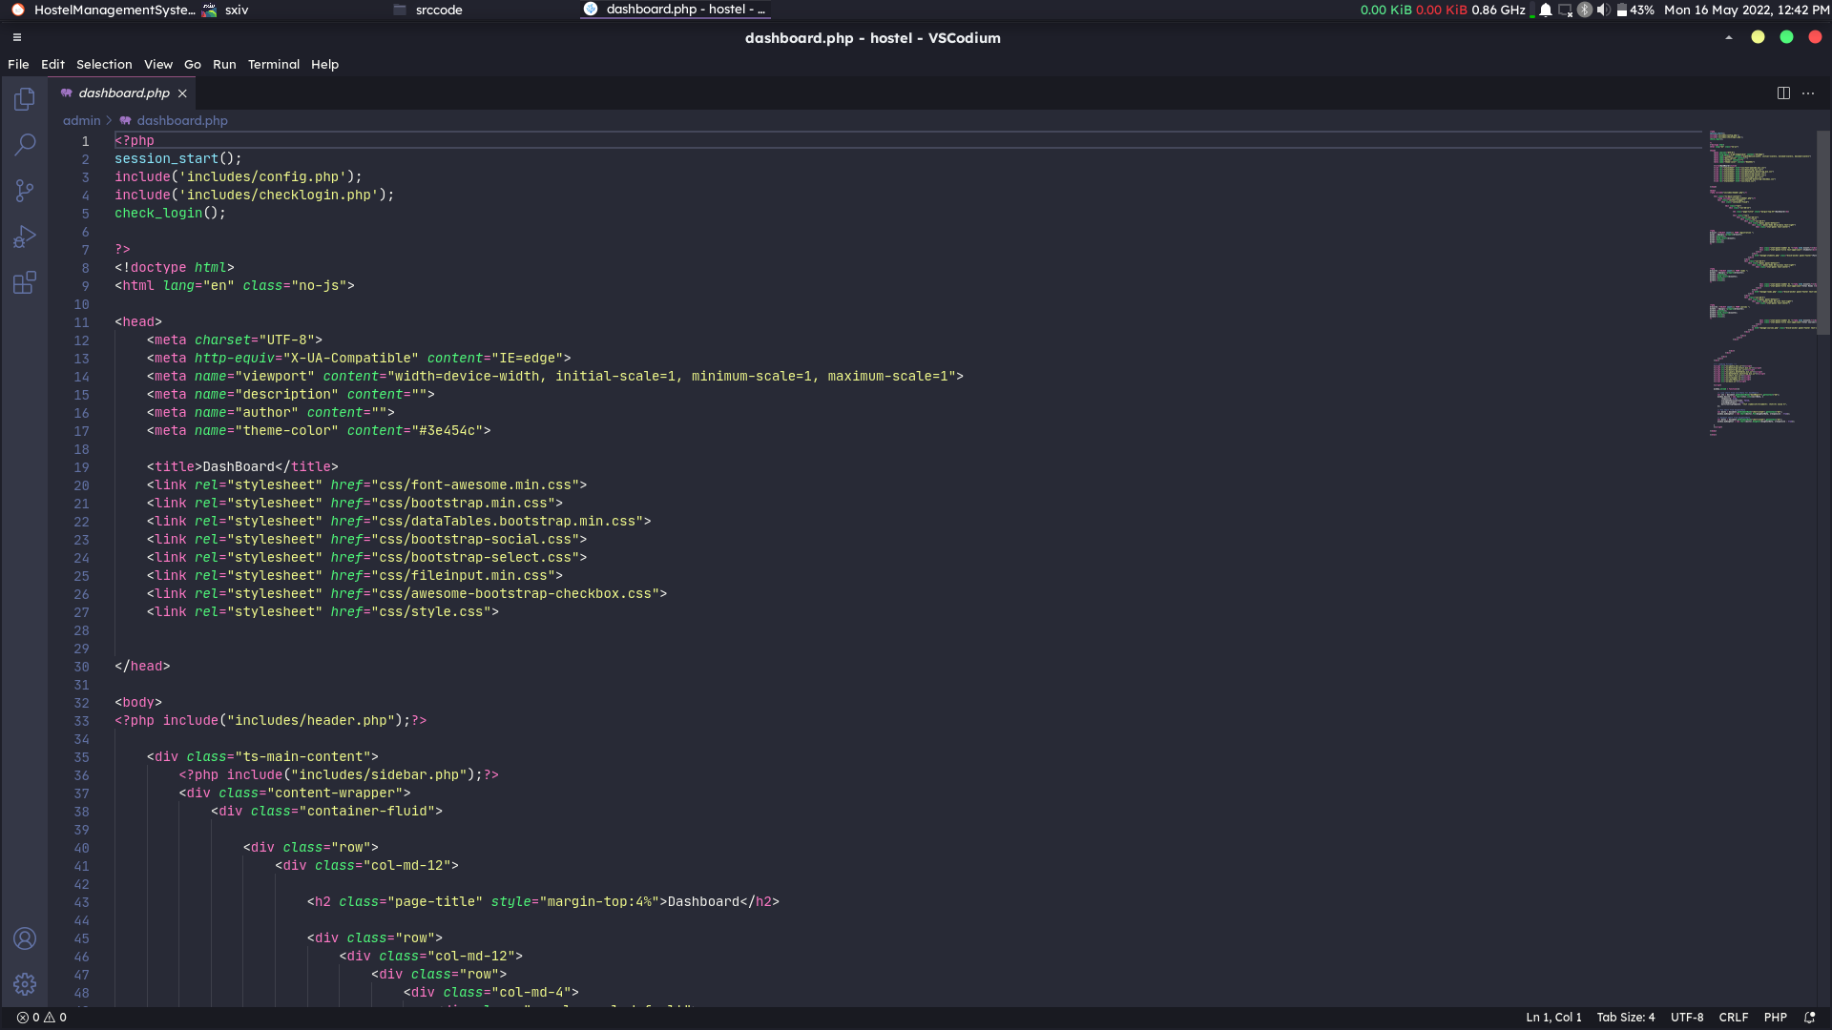
Dashboard.php

Slide 25
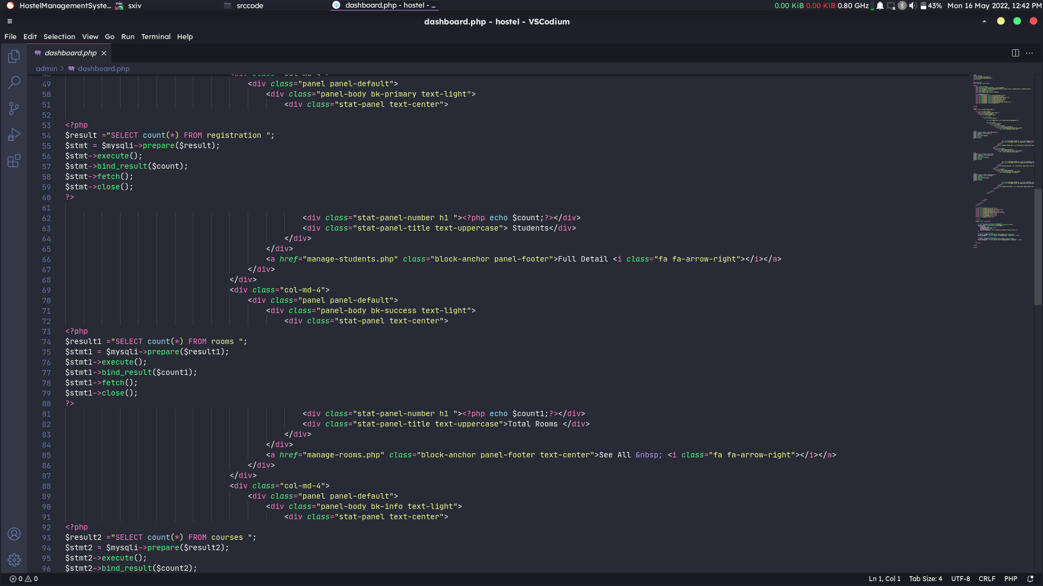
Dashboard.php Page-2

Slide 26
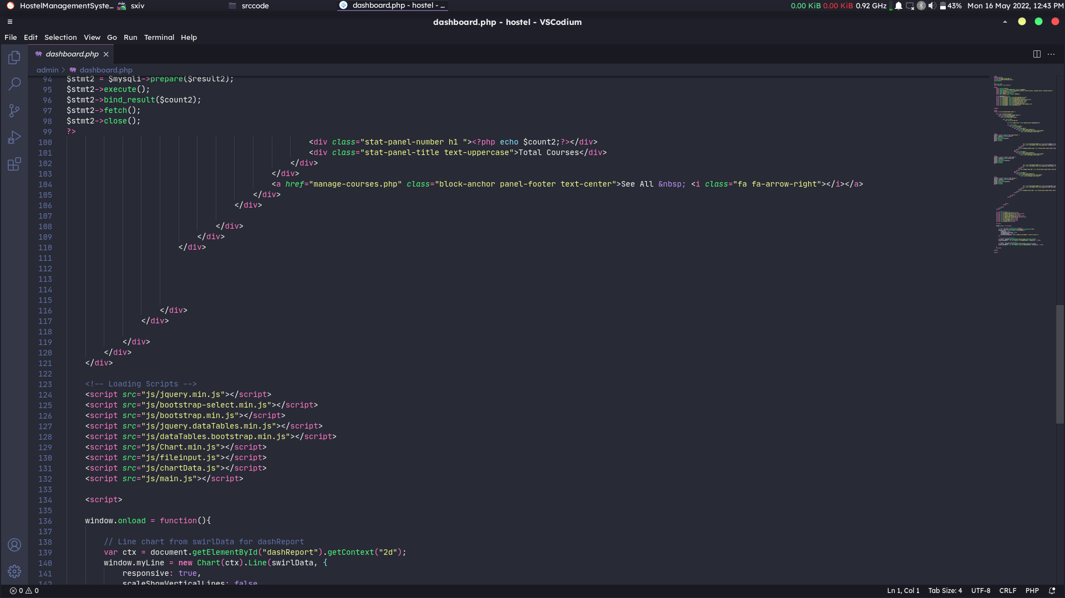
Dashboard.php Page-3

Slide 27
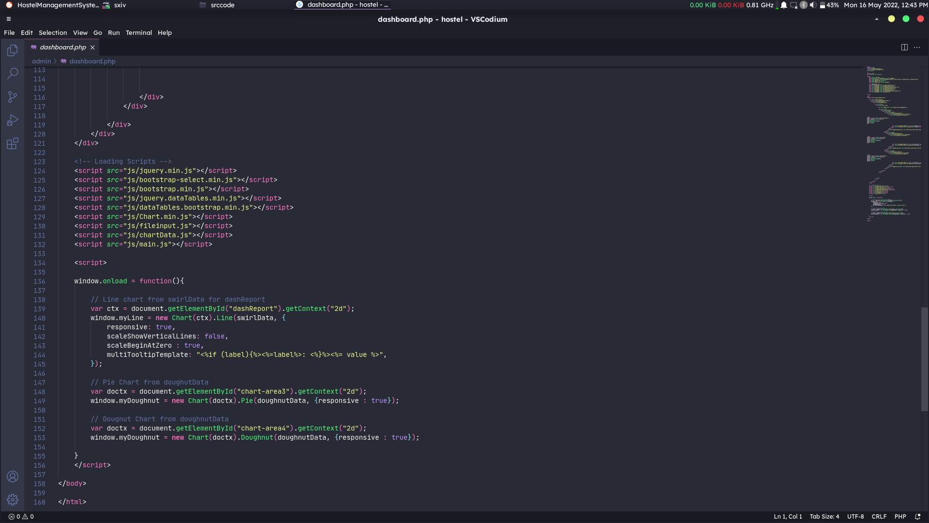
Dashboard.php Page-4

Slide 28
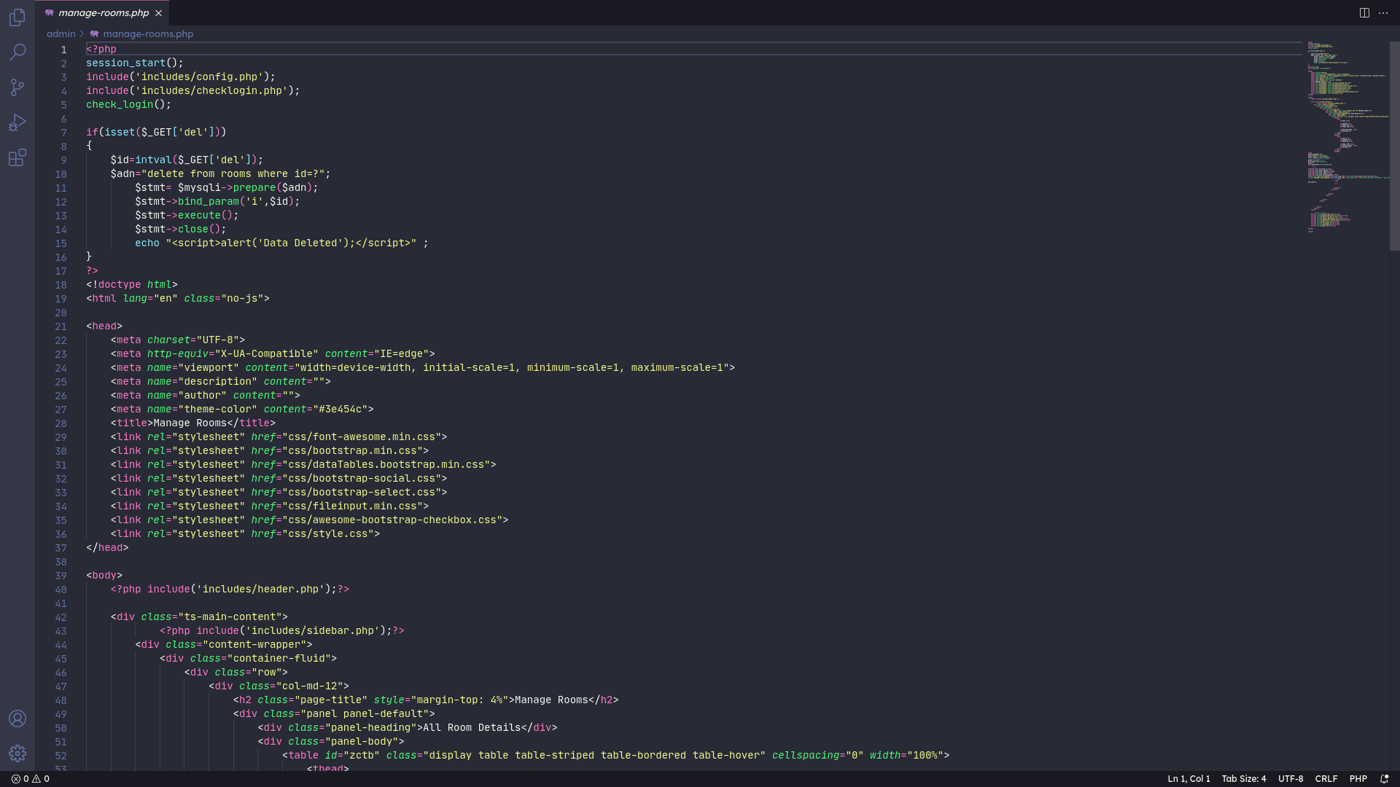
ManageRoom.php

Slide 29
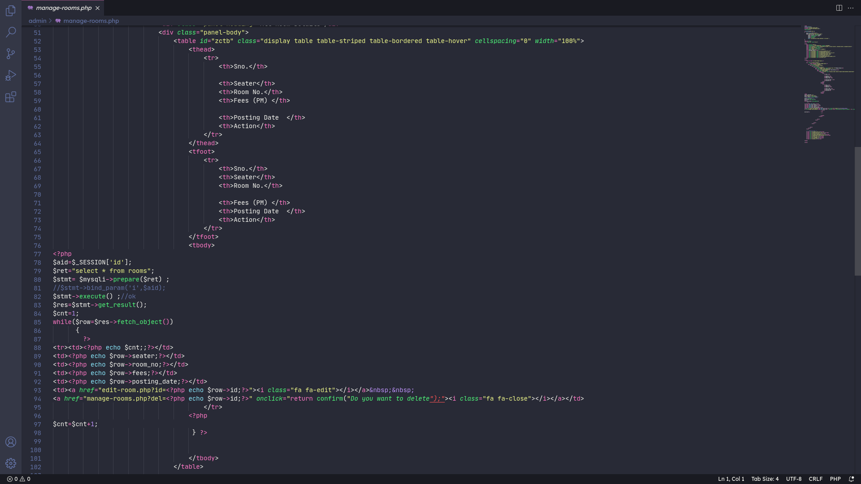
ManageRoom.php page-2

Slide 30
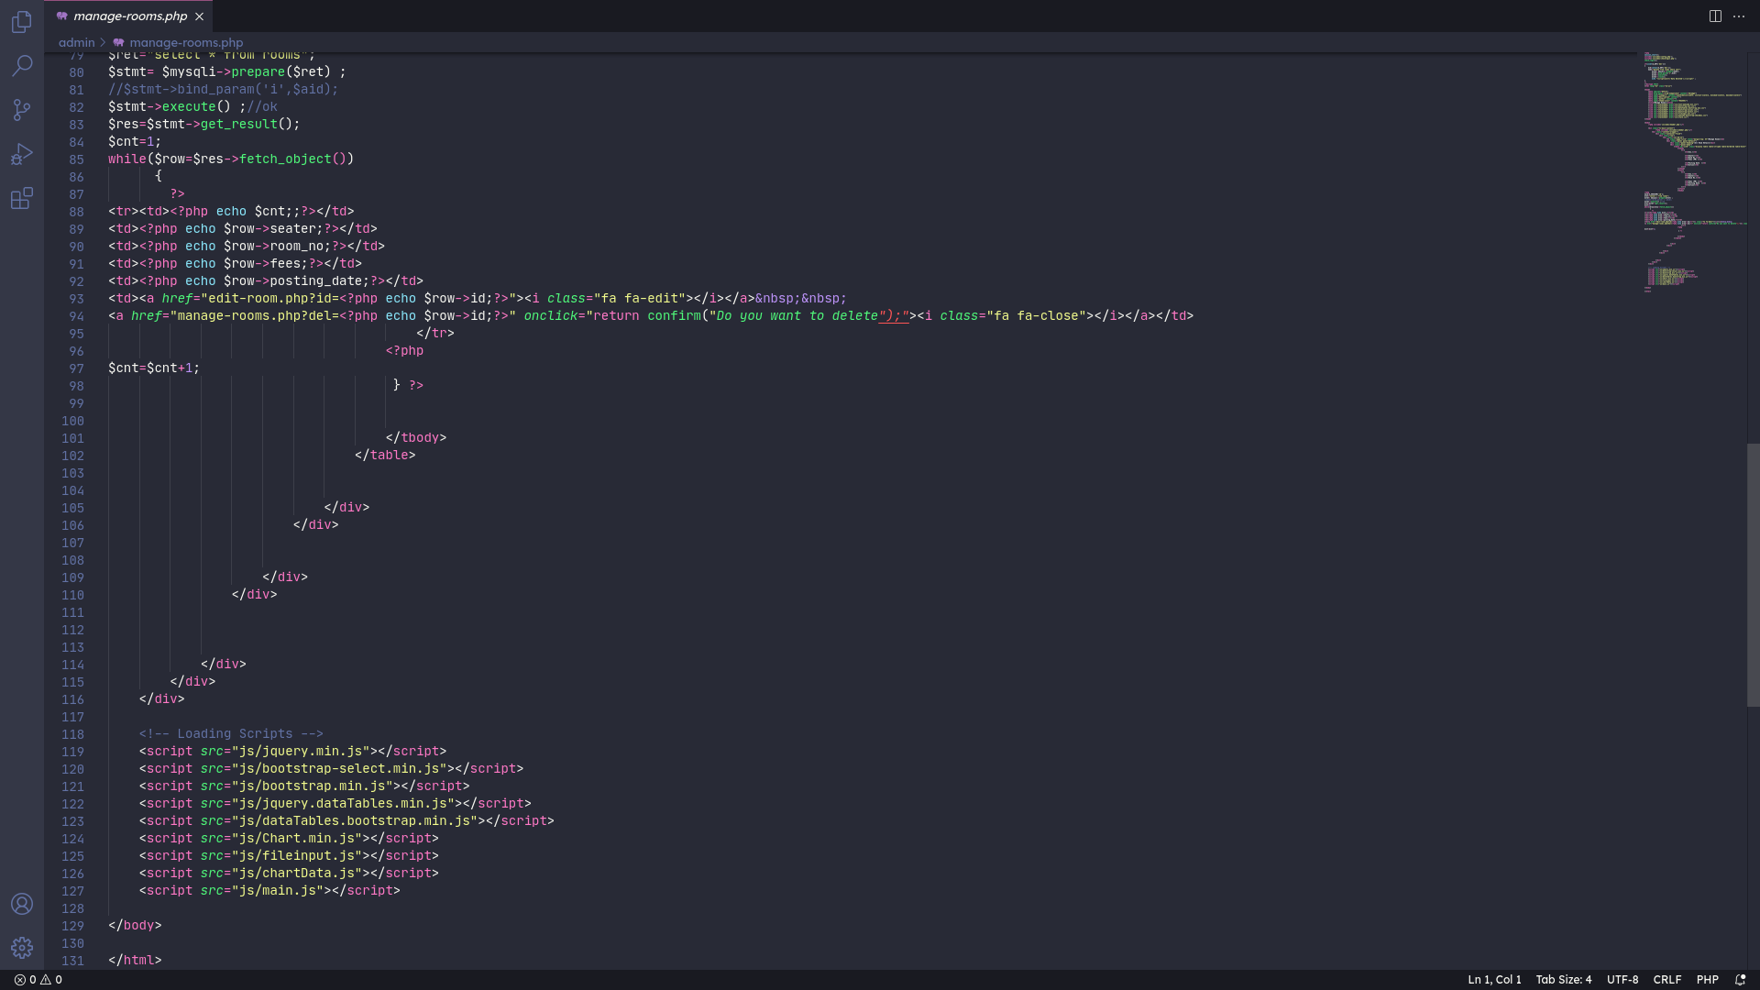
ManageRoom.php page-3

Slide 31
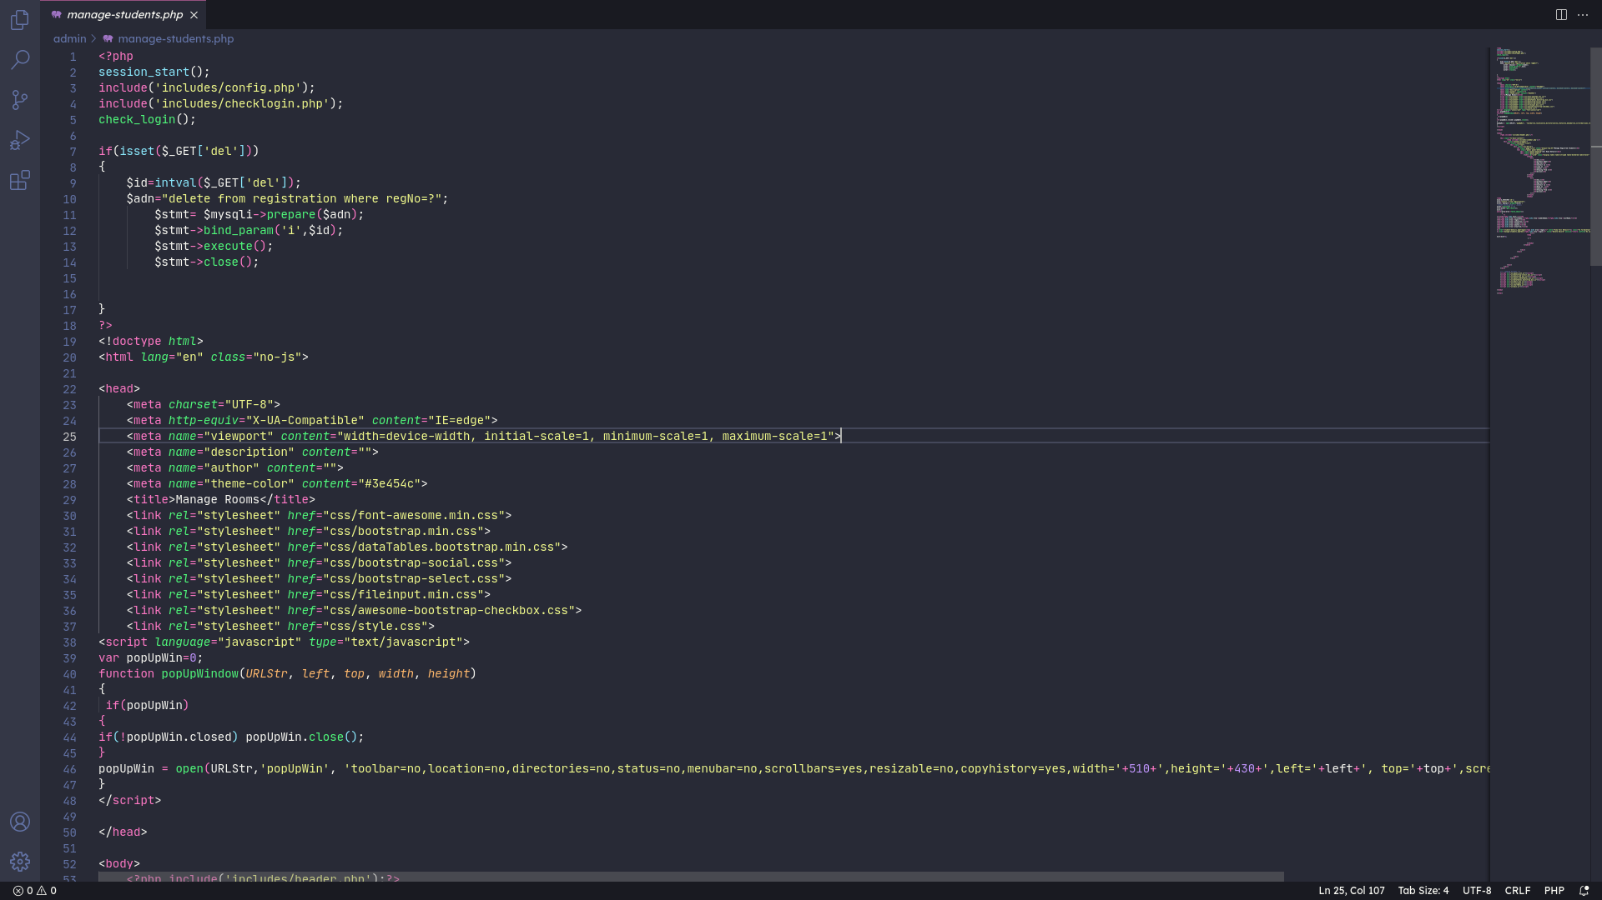
ManageStudent.php

Slide 32
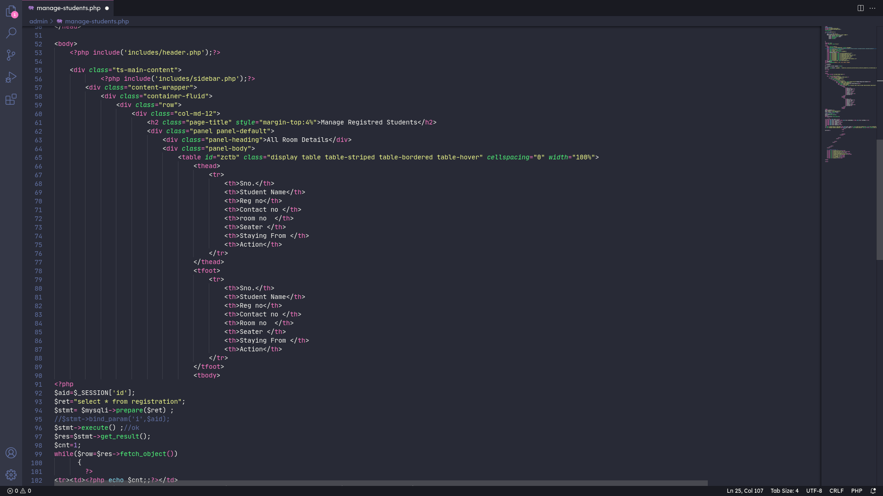
ManageStudent.php page-2

Slide 33
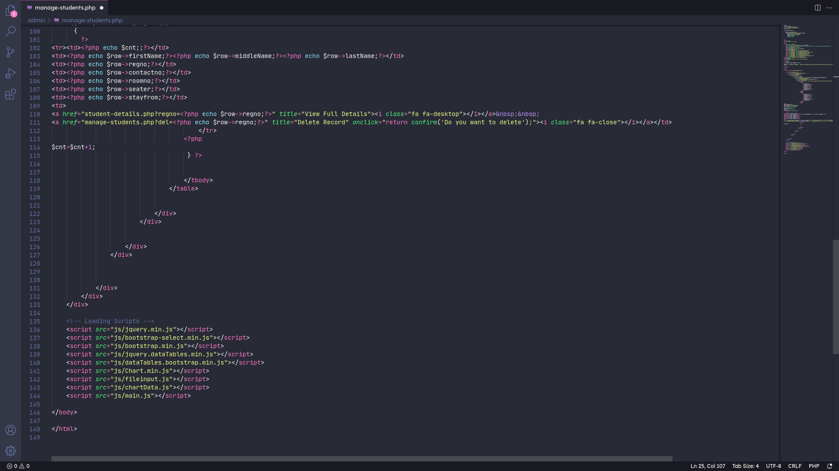
ManageStudent.php page-3

Slide 34
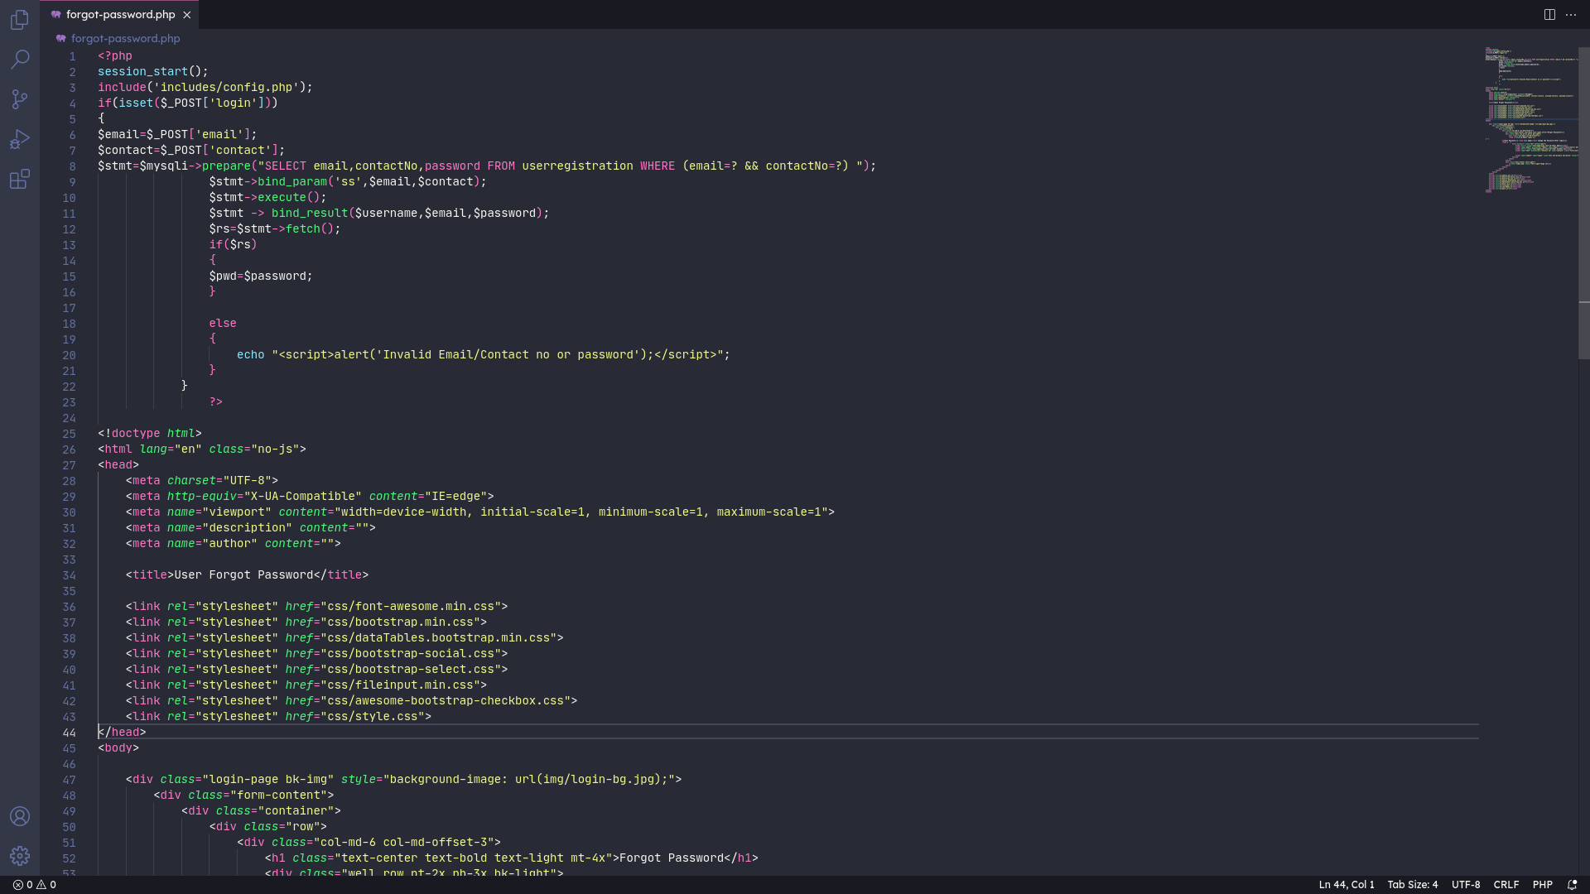
ForgotPassword.php

Slide 35
ForgotPassword.php page-2

Slide 36
THANK YOU... :)

